Slide 1
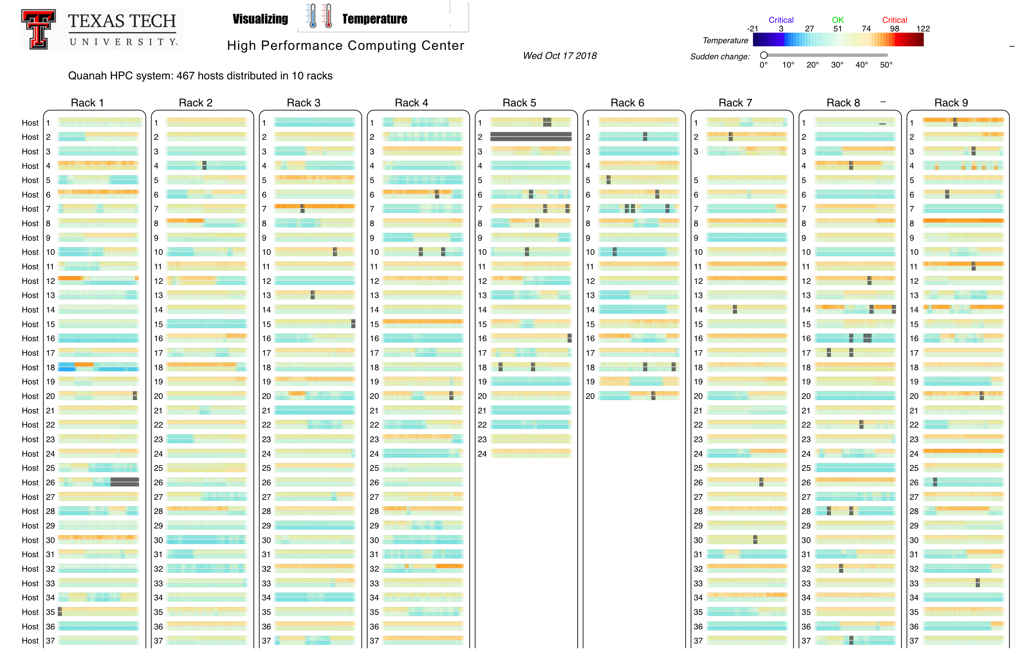

Slide 2
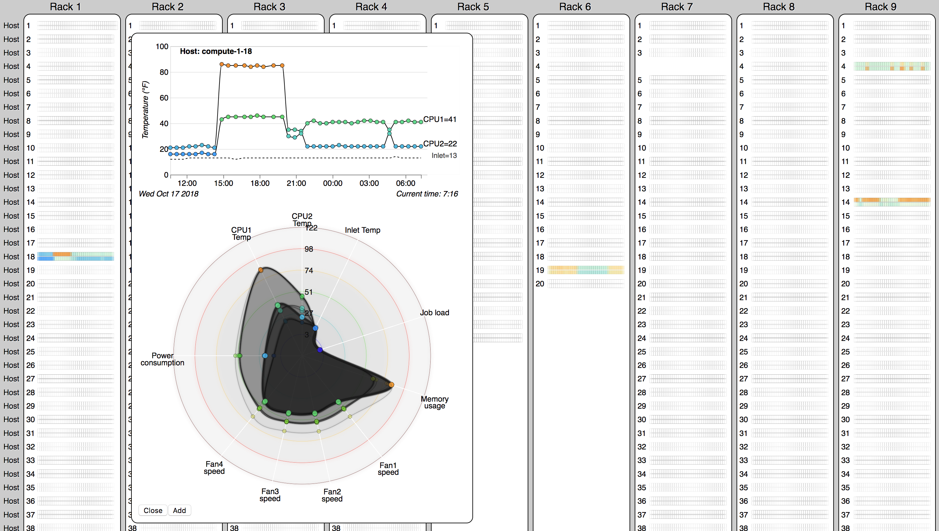
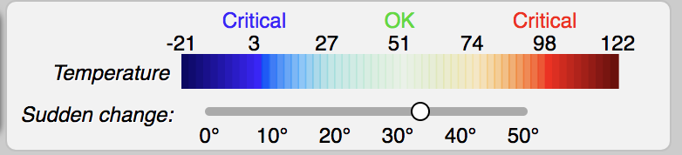
Filter CPUs with ∆ temperature > 35 F

Slide 3
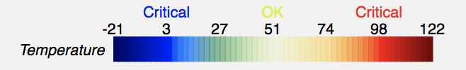
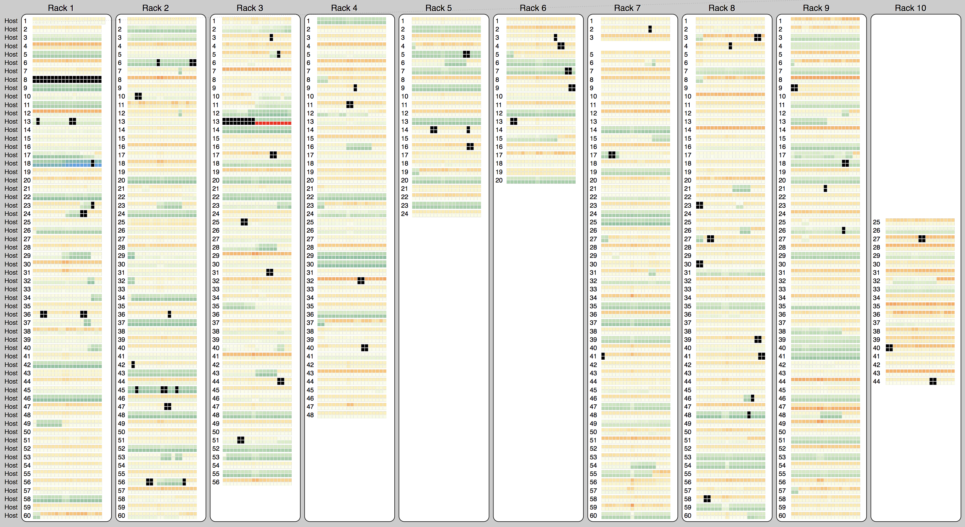
HPCC on Sep, 26 2018: CPU overheat

Slide 4
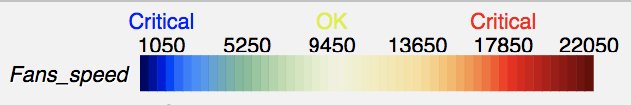
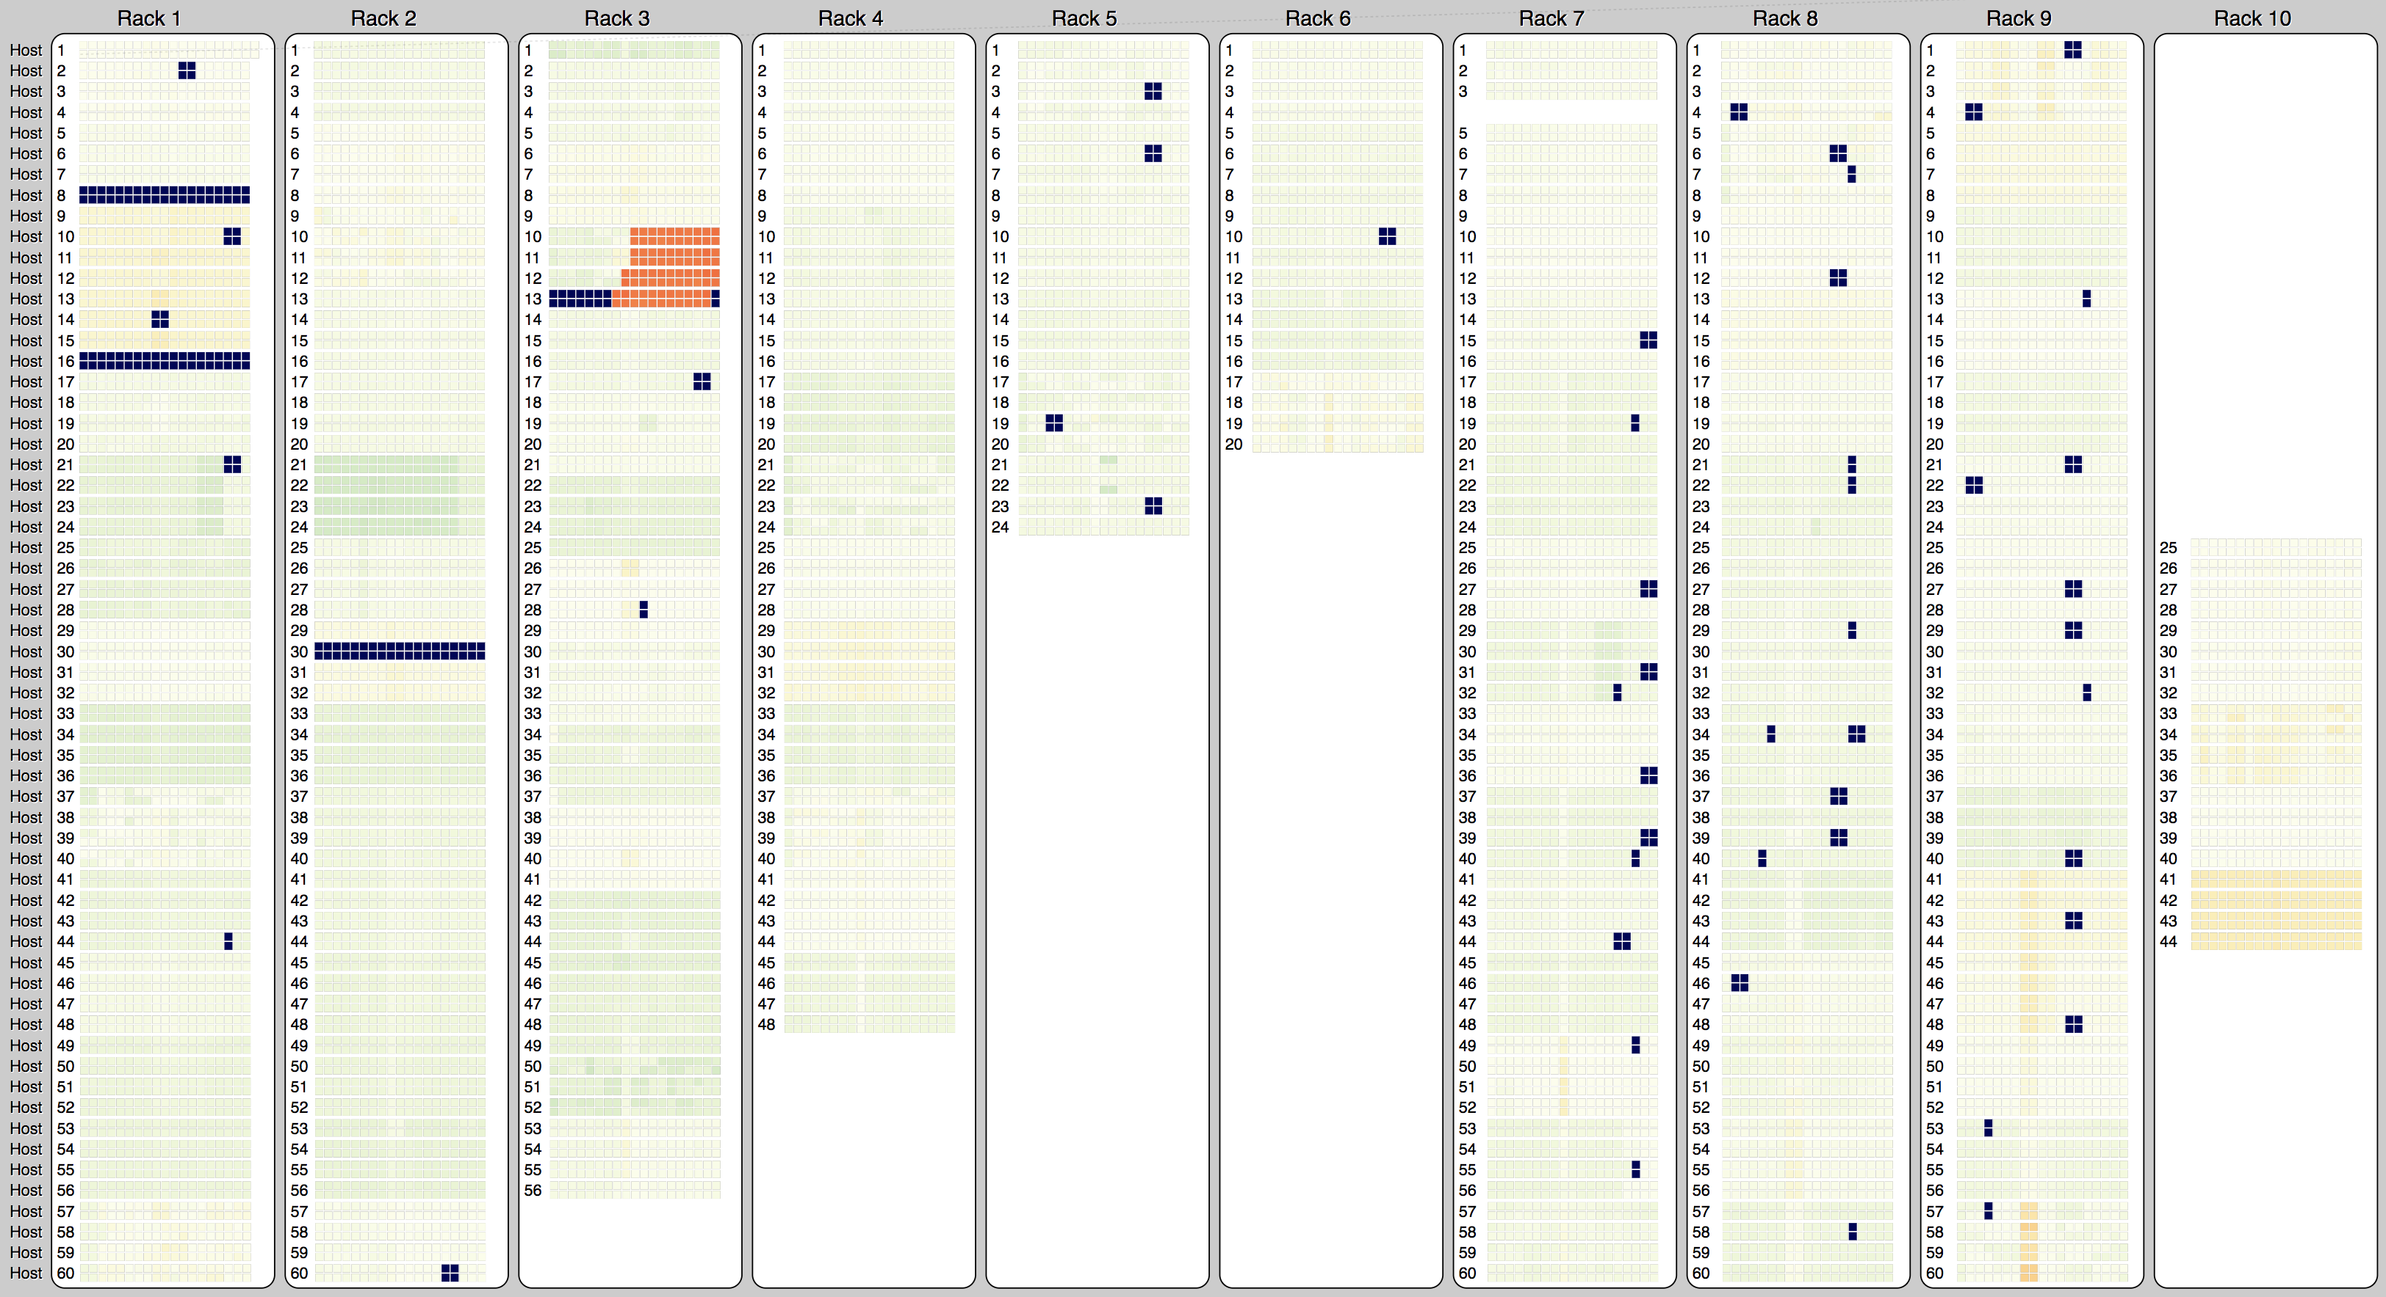
HPCC on Sep, 26 2018: Fan speeds

Slide 5
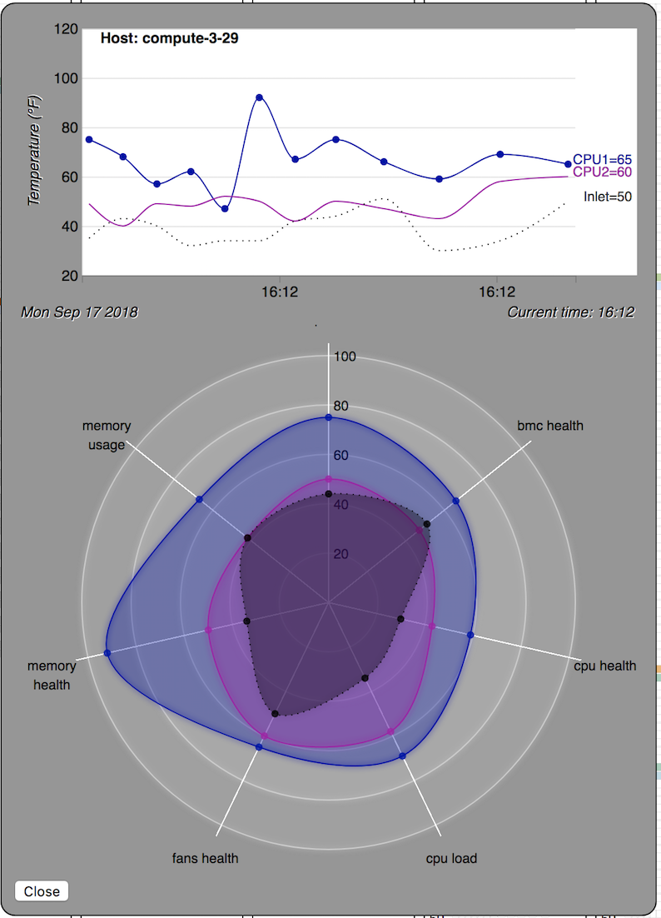
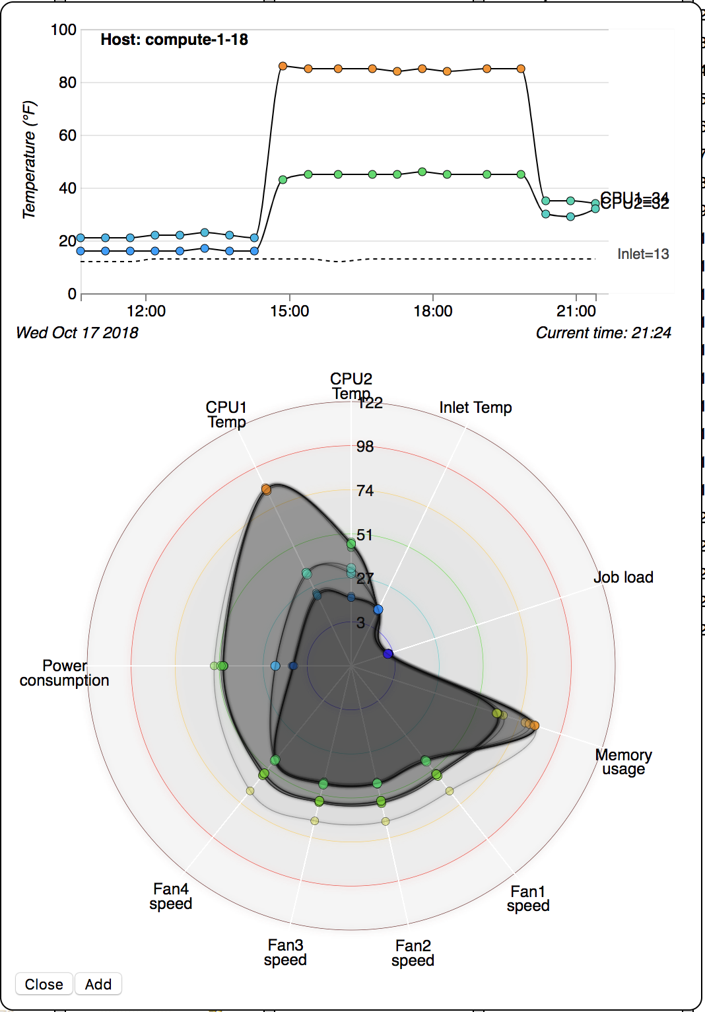
Original 7 axis multi-axis pop up dialog
The modified 10 axis pop up dialog

Slide 6
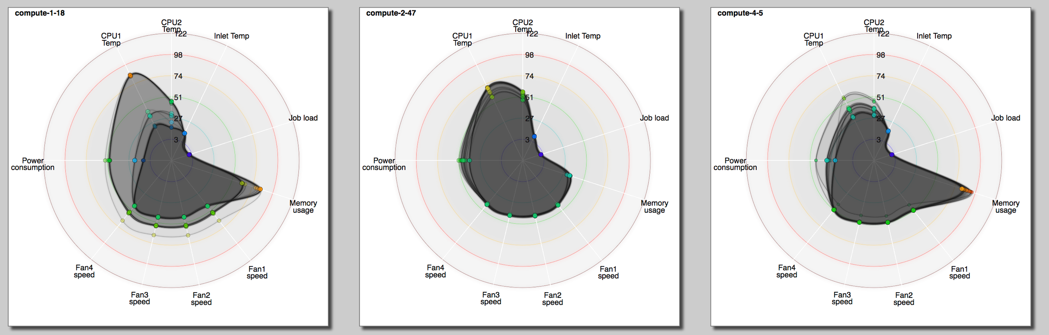
More examples of 10 axis Radar chart

Slide 7
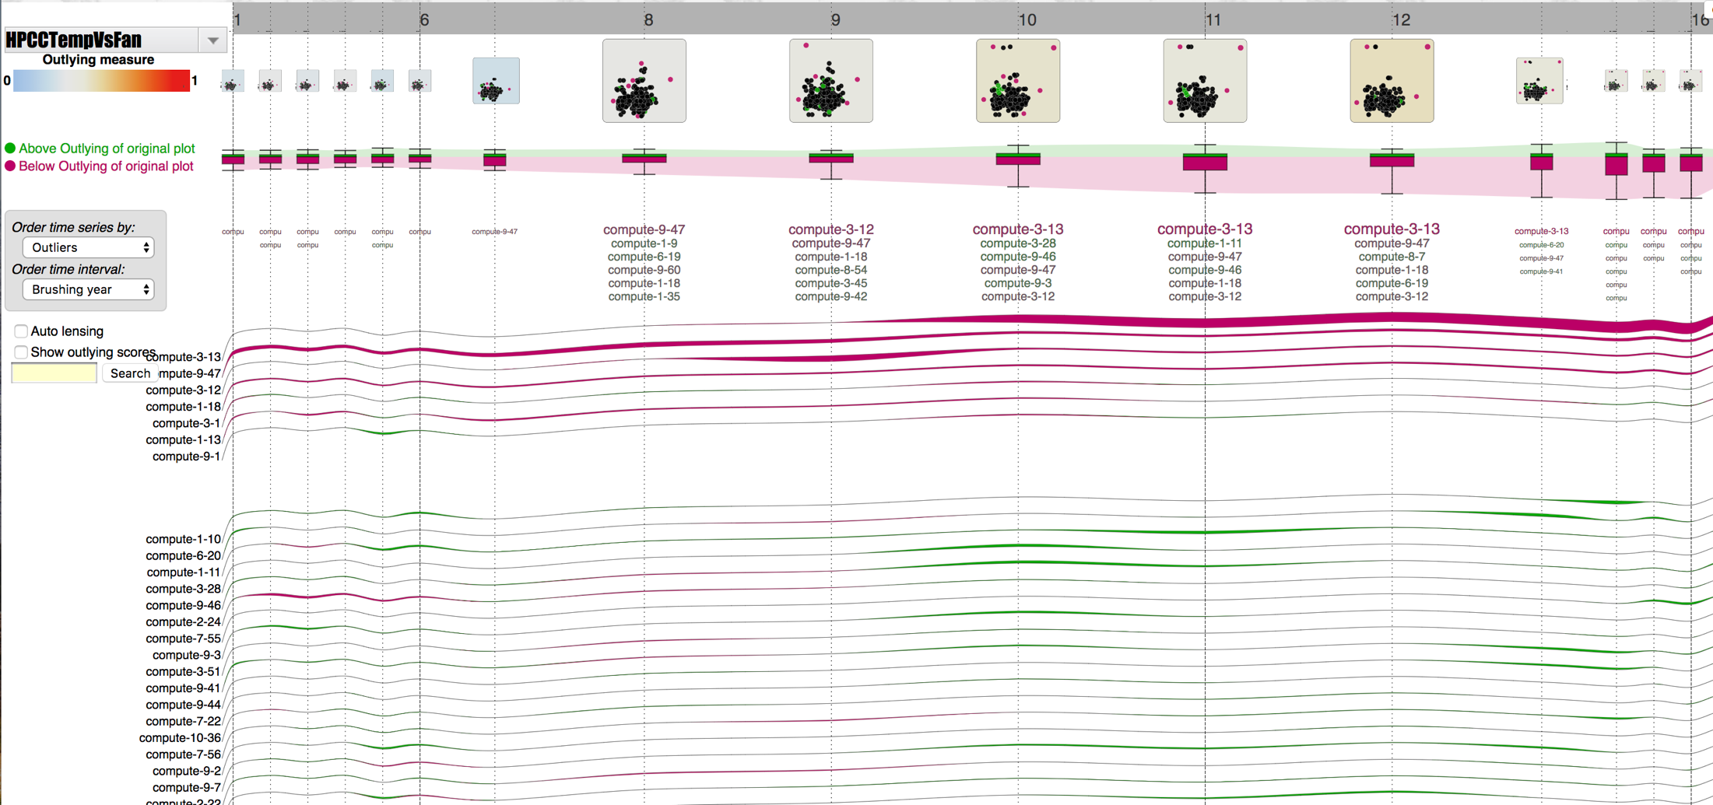
HPCC on Sep, 26 2018: CPU temperature vs Fan speed
Compute 3-13 is the outlier for a few hours due to overheat
Outlying time series of hosts

Slide 8
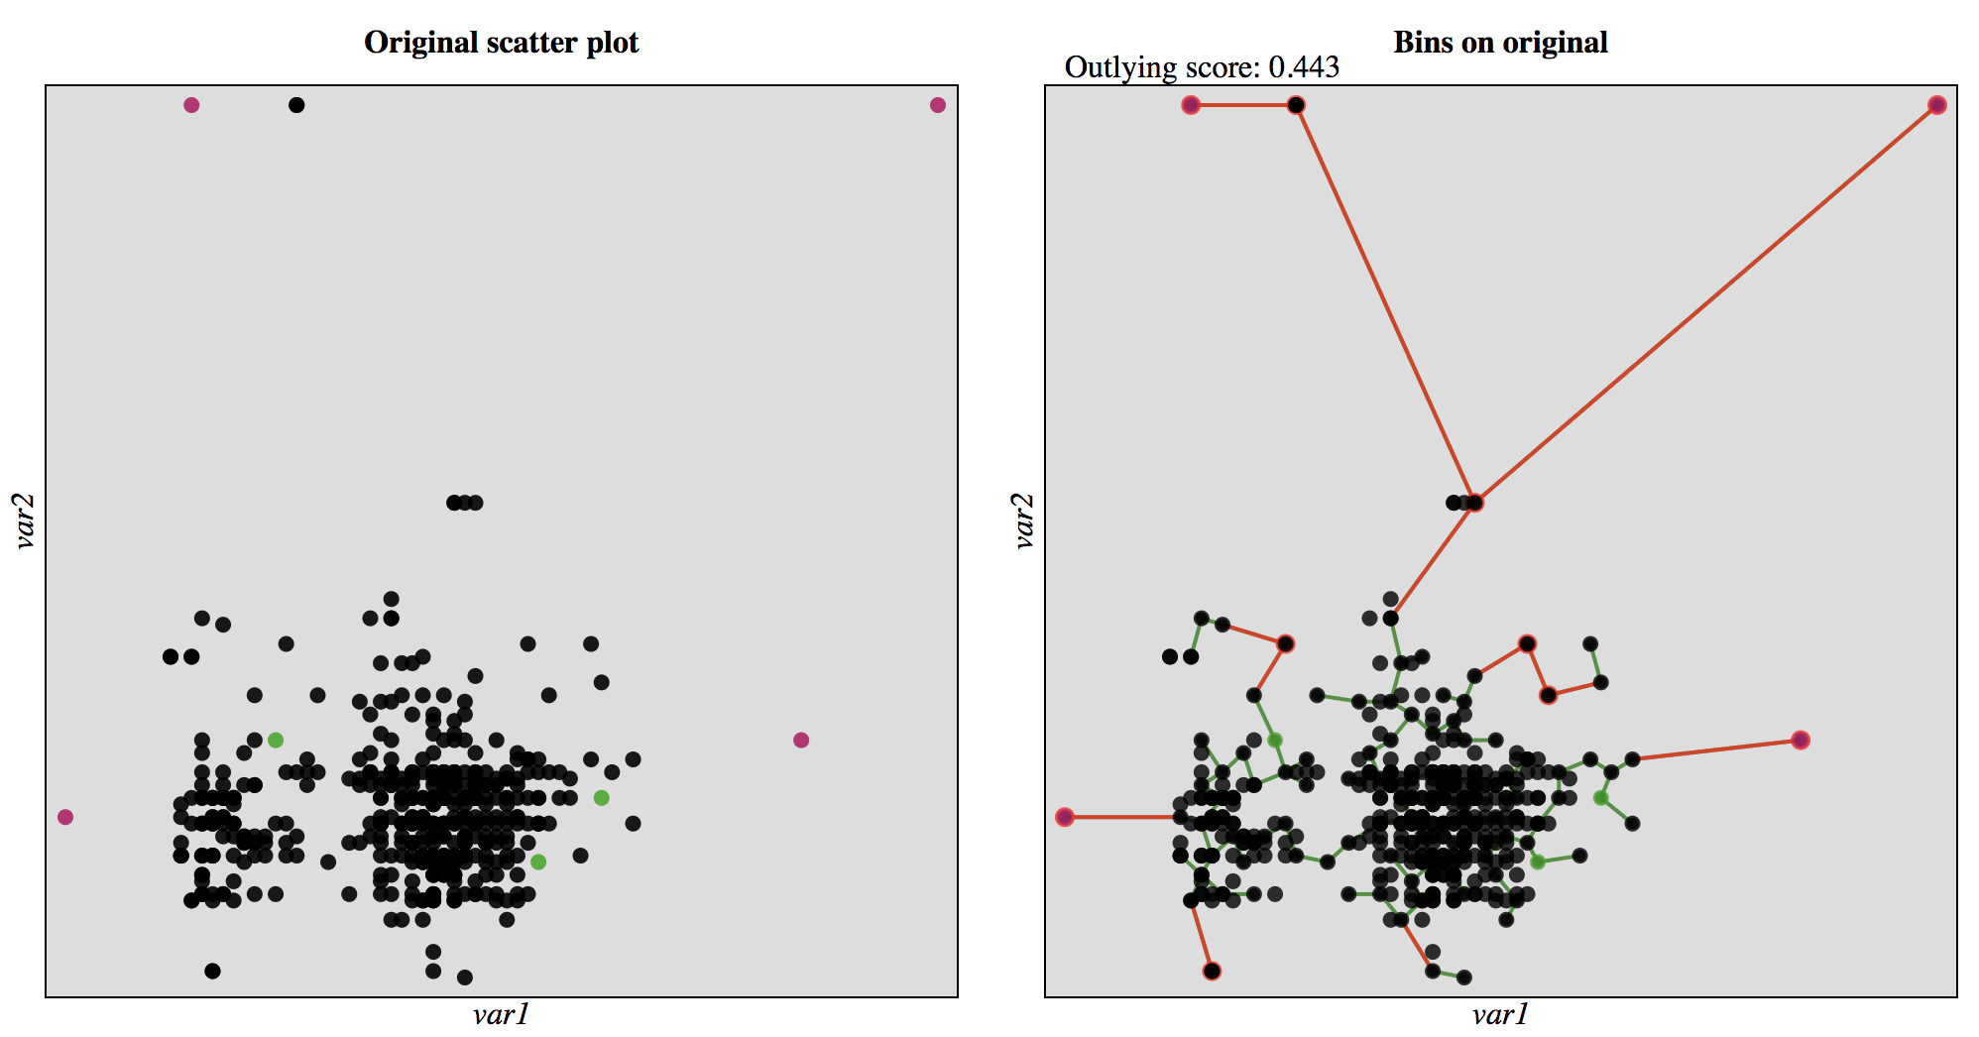
HPCC on Sep, 26 2018: CPU temperature vs Fan speed
Compute 3-13
CPU temperature
CPU temperature
Fan speed
Fan speed

Slide 9
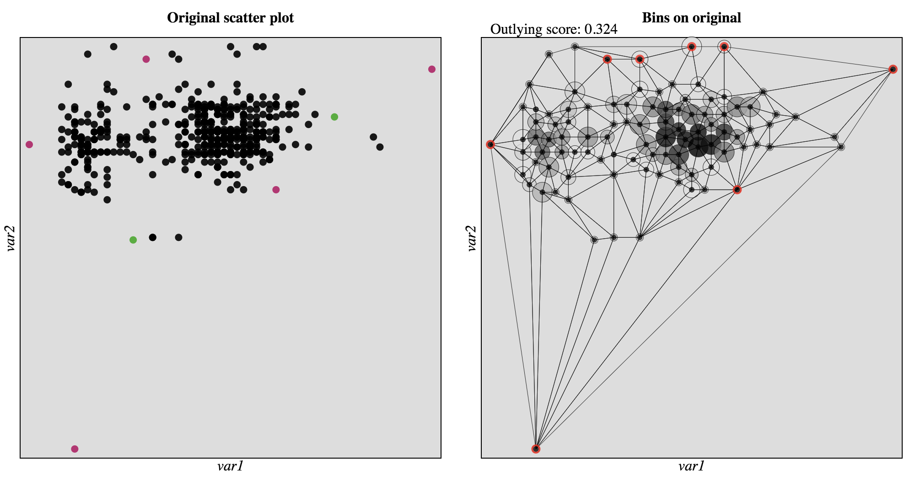
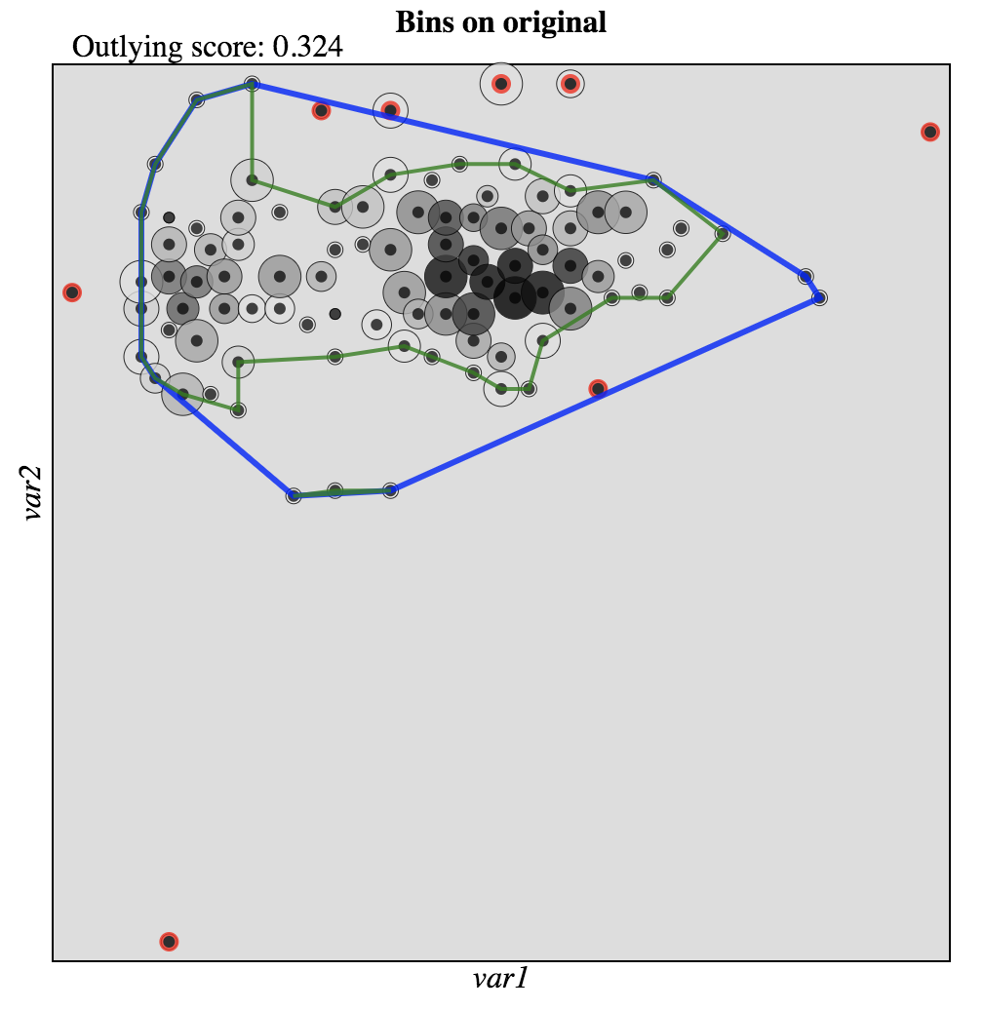
HPCC on Sep, 26 2018: CPU temperature vs Fan speed
CPU temperature
CPU temperature
CPU temperature
Outlier
Outlier
Fan speed
Fan speed
Fan speed

Slide 10
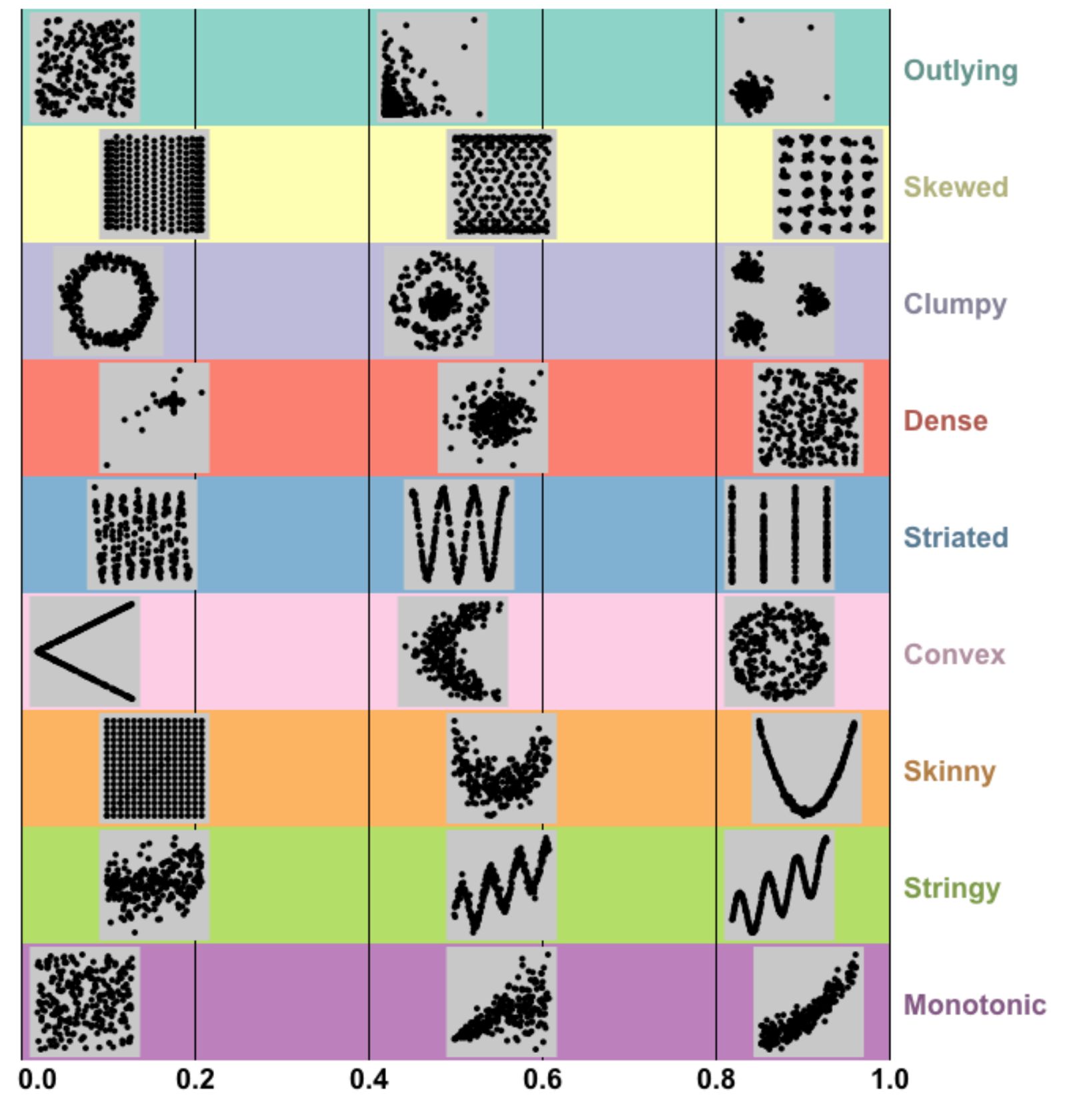
Multi-dimensional analytics

Slide 11
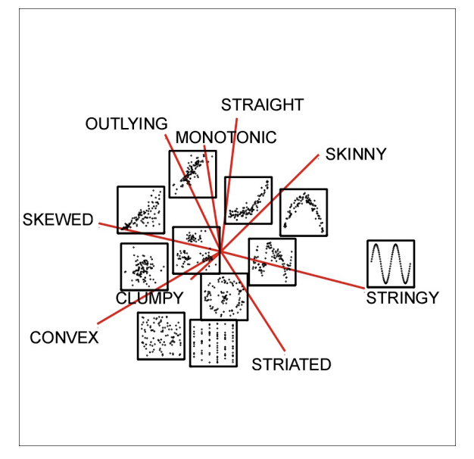
Example scatterplot and features on PCA

Slide 12
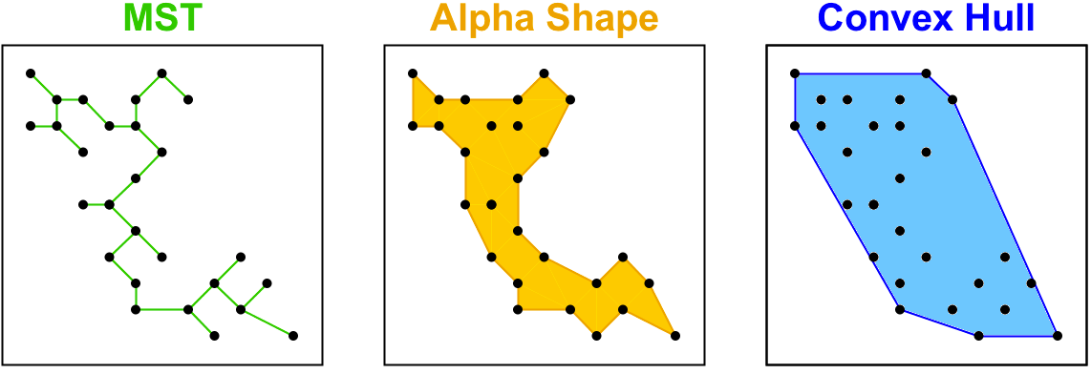
Multi-dimensional analytics

Slide 13
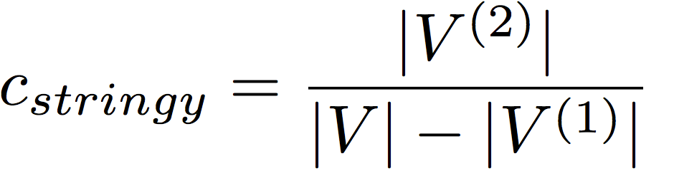
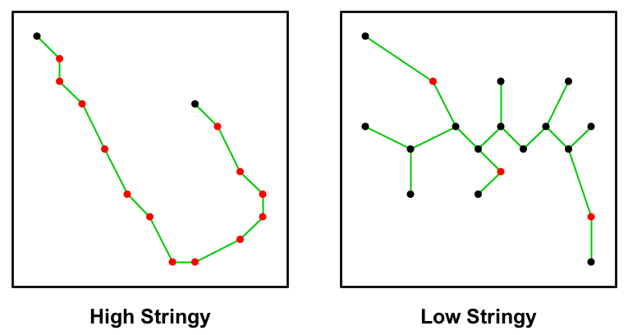
Example: STRINGY feature

